Slide 1
Trainning for trainners BLASK, Birzai, 2022-04-14
Project: INsport – Sport for social inclusion and social inclusion for sport
Project Number: 622057-EPP-1-2020-1-LT-SPO-SSCP
Erasmus+ Sport – Small Collaborative Partnership

Slide 2
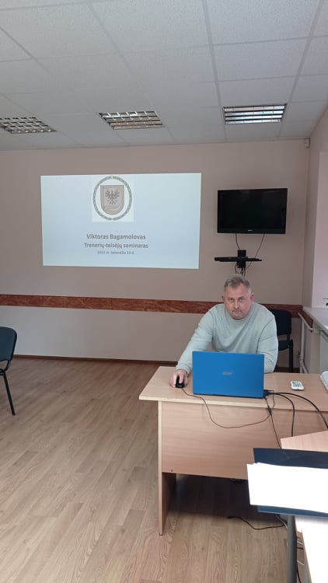
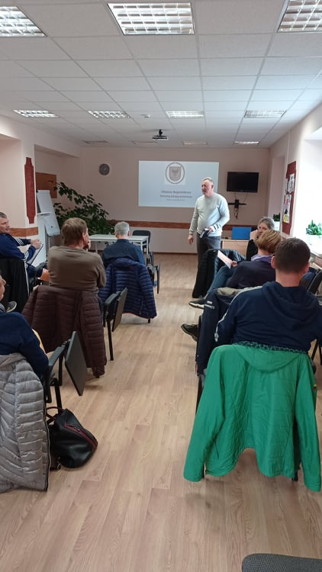

Slide 3
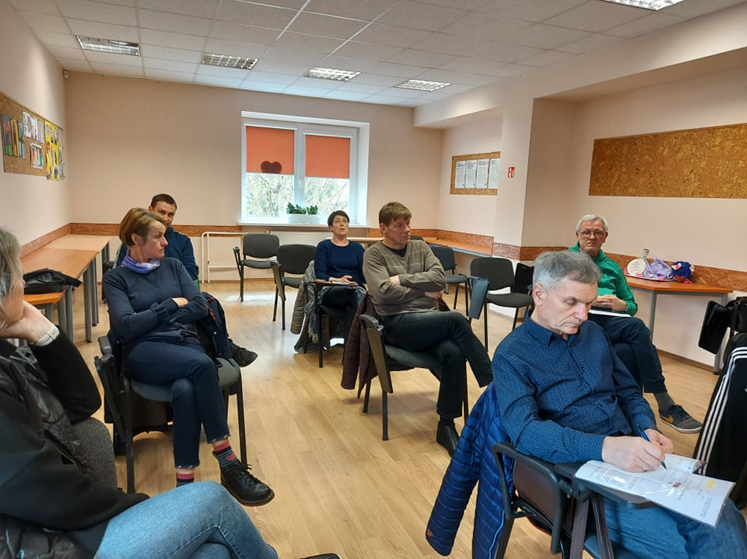

Slide 4
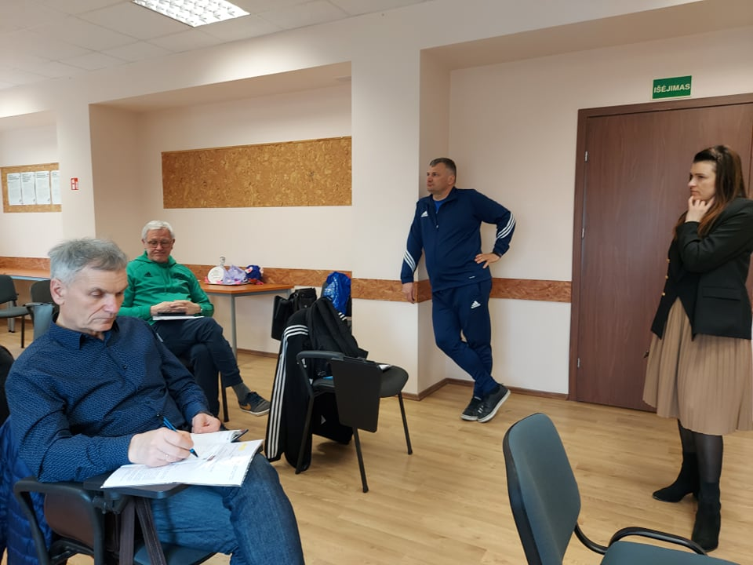

Slide 5
